Slide 1
2026 NFHS Field Hockey Rules Changes

Slide 2

1-6-1 Player Equipment –
Mouth Protectors
Mouth protectors shall:
Not include any attachment(s) that do not serve a purpose in protecting the teeth or mouth.
Not include anything that creates a health or risk issue.
Not pose a danger to the wearer or to other players.
Notes:
This rule change addresses player equipment. It ensures player safety is paramount, and these updates clarify what is permissible. Key takeaways here are:
Mouth protectors should focus purely on protection. Any attachments that don't serve to protect the teeth or mouth are not allowed. This aims to eliminate distractions or potential hazards.
Mouth protectors must not pose any health or risk issue.
- The mouth protector must not pose a danger to the player, or to other players on the field. This applies to attachments that might snag, break off, or otherwise become a hazard during play.

Slide 3
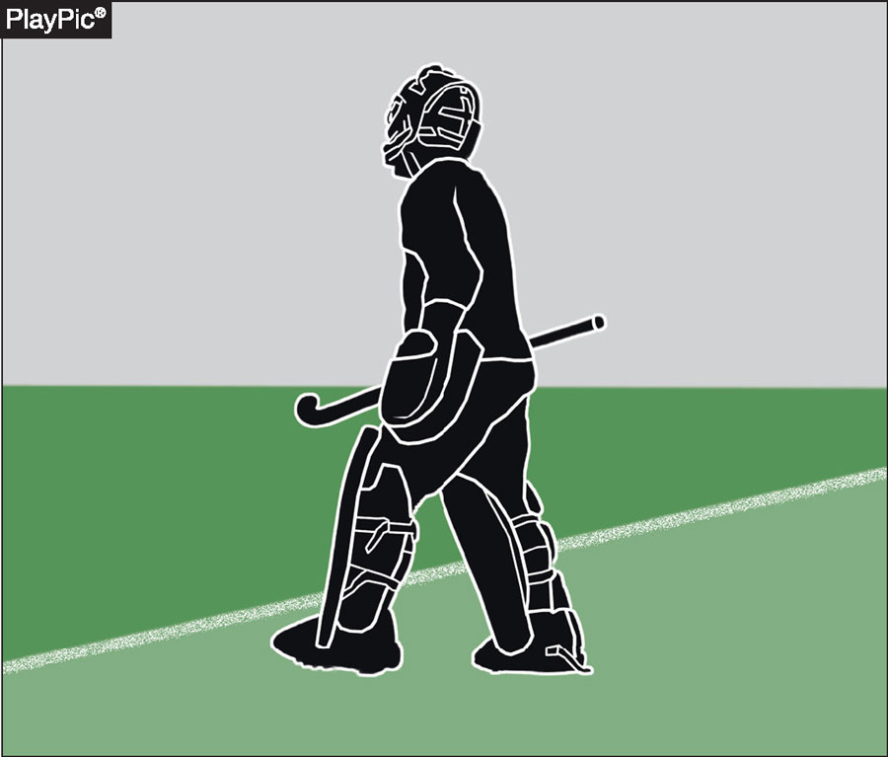
4-4-3 Substitutions and
Penalty Corners
Exceptions - Substitutions are NOT permitted prior to a penalty corner, except when:
A goalkeeper is ill, injured, suspended or disqualified
If the goalkeeper is suspended or disqualified:
A properly equipped goalkeeper must enter.
Another field player must leave.
The team continues with one fewer player.
Notes:
Substitutions are not allowed prior to a penalty corner.
However, there is one critical exception where a substitution would be permitted:
If the goalkeeper is ill, injured, suspended or disqualified.
If a goalkeeper is suspended or disqualified, specific steps must be followed:
A properly equipped goalkeeper must immediately enter the game.
Another field player from the team must leave the game
8-2-1 PENALTY 3

Slide 4
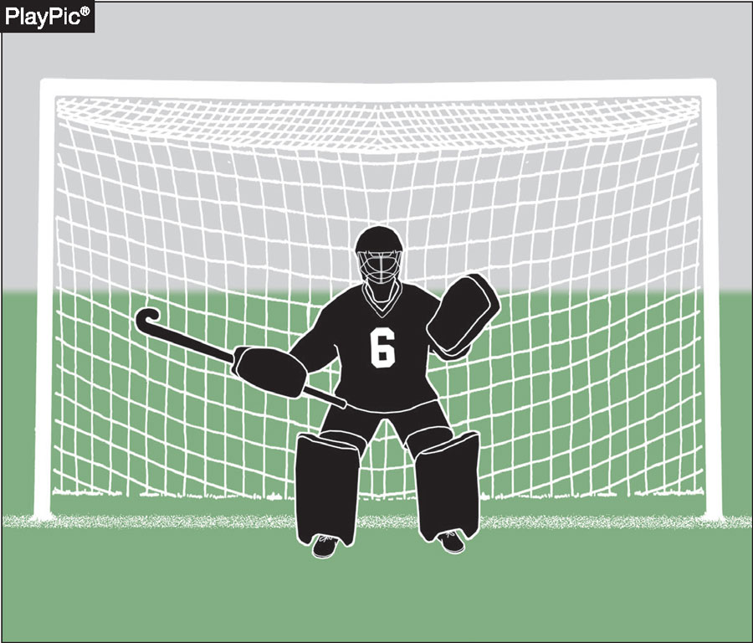
4-4-3 Purpose of the New Language
The Rules Committee noted the new language: “Ensures a properly equipped goalkeeper is in place and at the same time preserves the integrity and continuity of the penalty corner procedure.”
Key Emphasis:
Prevents tactical substitutions
Preserves flow of the penalty corner
Ensures safety and proper equipment.
Notes:
Preventing tactical substitutions: We want to avoid teams using substitutions to gain a strategic advantage right before a penalty corner, for instance, bringing on a specialist defender.
Preserving the flow of the penalty corner: The penalty corner is a critical play, and minimizing interruptions helps maintain the game's rhythm and excitement.
Ensuring safety and proper equipment: Above all, it reinforces the need for all players, especially the goalkeeper, to be safely and appropriately equipped at all times, even during these high-pressure moments."

Slide 5
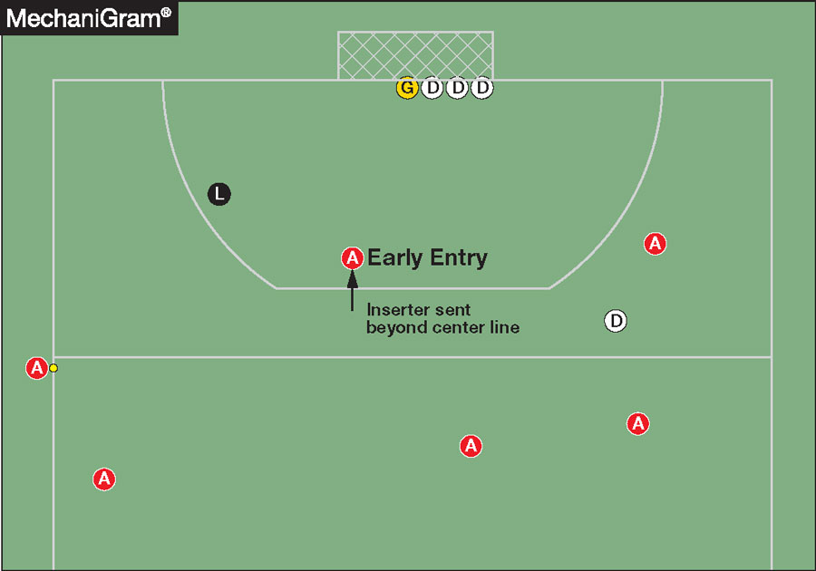
10-3-3 Attacker Enters Circle Early – Who Goes Beyond?
If an attacker enters the circle before the ball is played:
The inserter must go beyond the center line.
Previously:
The offending player was required to go beyond the center line.
The Rules Committee explained:
“This approach simplifies enforcement by removing uncertainty about which player must be sent back and promotes consistent positioning prior to the penalty corner.”
“It reinforces proper timing and discipline by the attacking team during the penalty corner setup.”
Notes:
If an attacker enters the circle early, the inserter the player who starts the penalty corner by passing the ball in – must now go beyond the center line.
This approach simplifies enforcement by removing uncertainty about which player must be sent back and promotes consistent positioning prior to the penalty corner

Slide 6
2026 NFHS Field Hockey Editorial Changes

Slide 7
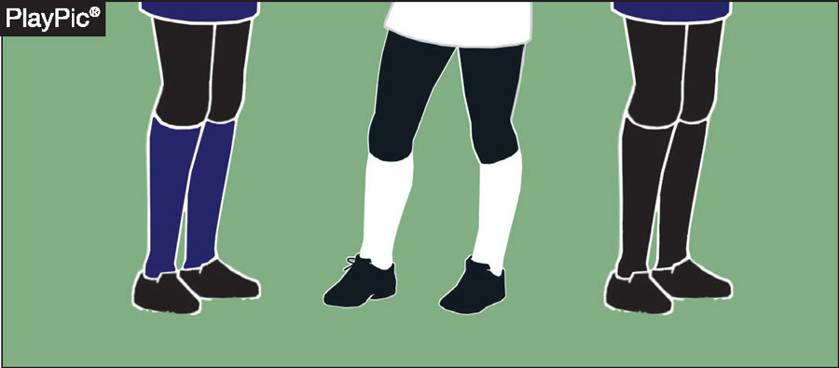
1-5-1f Player Uniform Socks
All uniforms shall adhere to the following:
The home team shall wear solid, knee-length, contrasting dark-colored socks, sock guards, not rolled down.
The visiting team shall wear solid, knee-length, white socks, sock guards.
Notes:
For the home team, socks must be solid, knee-length, and a contrasting dark color. Importantly, sock guards must be worn, and socks should not be rolled down.
For the visiting team, solid, knee-length, with sock guards, their socks must be white.

Slide 8
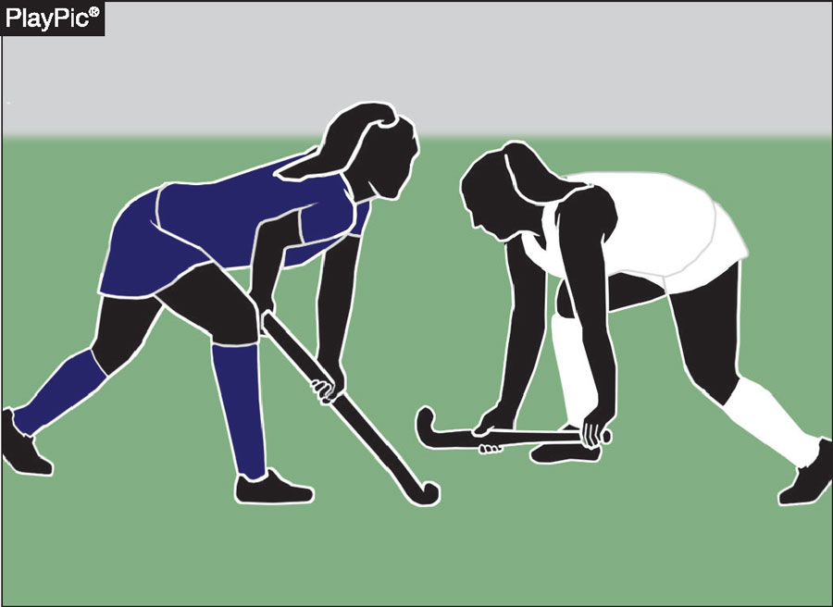
1-5-1f Editorial Rationale
Brings alignment to rule 1-5-1b
Established the home team wears dark jerseys.
The visiting team wears white jerseys.
Notes:
This mandates dark-colored jerseys for the home team and white jerseys for the visiting team. Making it easier to distinguish teams on the field and ensuring a cohesive uniform standard throughout the rulebook

Slide 9
2026 NFHS Field Hockey Points of Emphasis

Slide 10
Penalty Corners:
Retaken vs. Subsequent Corners
Key Distinction
A retaken penalty corner occurs when a foul happens during the initial penalty corner before completion.
The original penalty corner is retaken.
Subsequent Penalty Corner
A new foul by the defending team after the original penalty corner is completed results in a subsequent penalty corner.
On a subsequent penalty corner, up to five defenders may participate.
Rule Reference: 10-3-1
Notes:
This slide clarifies the difference between a retaken and a subsequent penalty corner. A retaken penalty corner occurs when a foul disrupts the original corner before it is completed, meaning the same corner is simply redone. A subsequent penalty corner results from a new defending foul after the original corner has concluded. The critical distinction is that on a subsequent penalty corner, up to five defenders may participate. Reference Rule 10-3-1 for the full language.

Slide 11
Penalty Corners: Early Entry Violations
Attacker Early Entry
If any attacker enters the circle before the ball is played:
  The inserter must go beyond the center line.
Defender Early Entry
If a defender enters the circle early:
  That player must go beyond the center line.
  The player may not be replaced.
Retaken Penalty Corner
Teams must play down a player for the retaken corner.
Subsequent Penalty Corner
Teams may return to full participation.
Rule References: 10-3-3, 10-2-11, 10-3 PENALTIES
Notes:
This slide addresses early entry violations by both attackers and defenders during a penalty corner. If an attacker enters the circle before the ball is played, the inserter must go beyond the center line. If a defender enters early, that specific player must go beyond the center line and may not be replaced. On a retaken corner, the team plays down a player; on a subsequent corner, full participation resumes. Reference Rules 10-3-3, 10-2-11, and 10-3 Penalties.

Slide 12
Penalty Corner Mechanics and Enforcement
Officials should emphasize:
Proactive positioning
Clear communication
Consistent enforcement
Purpose of Consistent Enforcement
Prevent repeated early entry violations
Promote continuity across levels of play
Reinforce proper penalty corner mechanics for players and coaches
Notes:
This slide outlines the officiating expectations surrounding penalty corner enforcement. Officials should prioritize proactive positioning, clear communication with players and fellow officials, and consistent application of the rules. Consistent enforcement prevents repeated early entry violations, promotes uniformity across all levels of play, and reinforces proper penalty corner mechanics for both players and coaches.

Slide 13
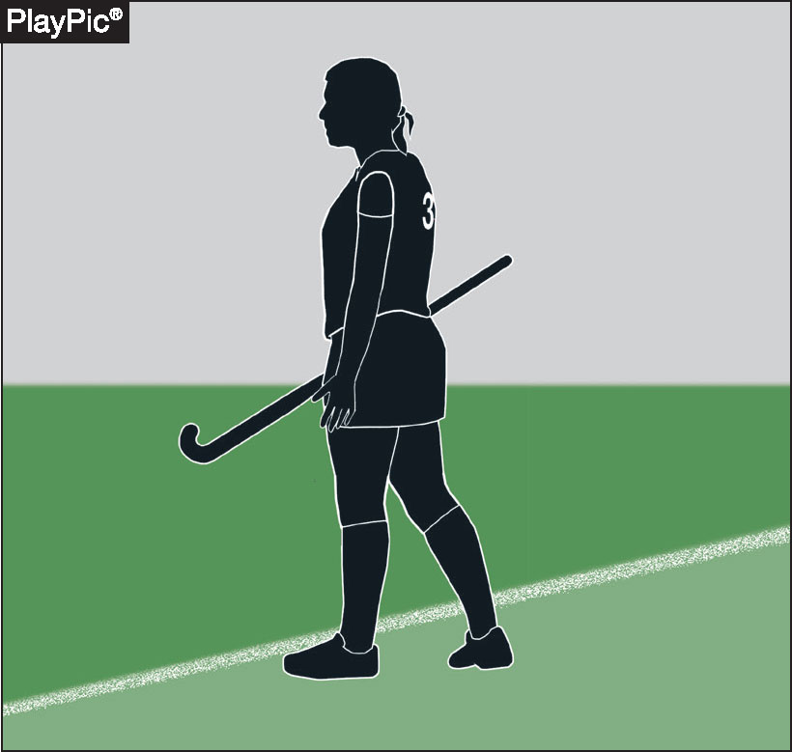
Substitution During a Penalty Corner
Substitution Restriction
No substitutions allowed from the time a penalty corner is awarded until it is completed.
Includes
Players returning from suspension
Exception
The goalkeeper may be replaced in cases of:
  Illness
  Injury
  Suspension
  Disqualification
Notes:
This slide covers the substitution restriction during a penalty corner. From the moment a penalty corner is awarded until it is completed, no substitutions are permitted, including players returning from suspension. The sole exception applies to the goalkeeper, who may be replaced in cases of illness, injury, suspension, or disqualification. This restriction preserves the integrity and continuity of the penalty corner procedure.

Slide 14
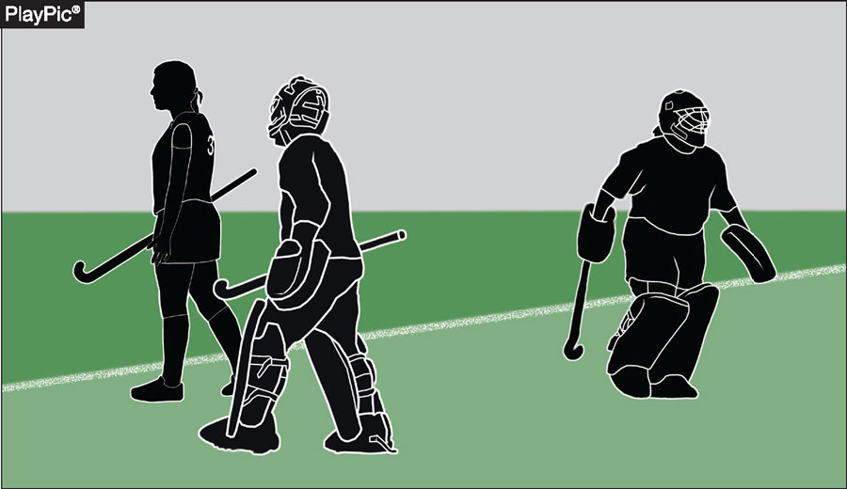
Goalkeeper Replacement During a Penalty Corner
If a goalkeeper is suspended or disqualified:
A properly equipped substitute goalkeeper must enter
Another field player must leave
The team continues with one fewer field player
Key Emphasis
Prevents tactical substitutions
Maintains fairness and continuity of the penalty corner
Rule References: 4-4-3, 10-3-1
Notes:
This slide details the specific procedure when a goalkeeper must be replaced during a penalty corner. If a goalkeeper is suspended or disqualified, a properly equipped substitute goalkeeper must enter the game, another field player must leave, and the team continues with one fewer field player. This rule prevents tactical substitutions and maintains fairness throughout the penalty corner. Reference Rules 4-4-3 and 10-3-1.

Slide 15
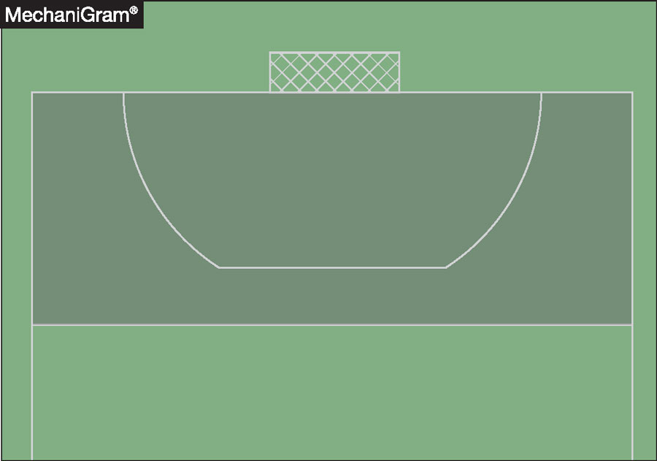
Wire-Caged Face Masks
Permitted Use
Smooth, rounded wire-caged face masks may be worn while defending a penalty corner.
After the Penalty Corner
The mask must be removed immediately when the penalty corner is completed.
Exception
If removal cannot safely occur immediately, the player may continue wearing it only inside the 25-yard area.
Notes:
This slide explains the use of wire-caged face masks during penalty corners. Smooth, rounded wire-caged face masks are permitted for defenders during a penalty corner. Once the penalty corner is completed, the mask must be removed immediately. The one exception is if removal cannot safely occur right away, in which case the player may continue wearing it only while inside the 25-yard area.

Slide 16
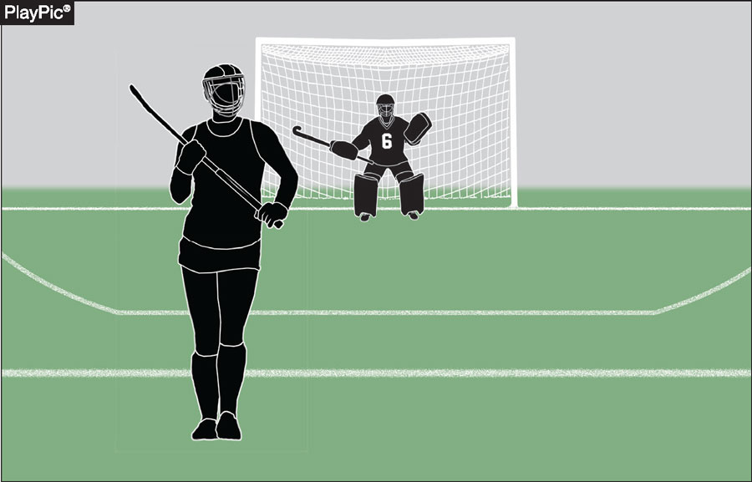
Face Mask Violation
Violation Occurs When
A player crosses the 25-yard line while wearing a wire-caged face mask.
If the Player Is Involved in Play
Officials may:
Stop play immediately
Award a free hit to the opponent at the 25-yard line
Issue a misconduct penalty
If Not Involved in Play
Address the violation at the next stoppage of play.
Rule References: 1-6-5, 8-2-1
Notes:
This slide addresses face mask violations and the appropriate official response. A violation occurs when a player crosses the 25-yard line while still wearing a wire-caged face mask. If the player is involved in play, officials should stop play immediately, award a free hit at the 25-yard line, and issue a misconduct penalty. If the player is not involved in play, the violation should be addressed at the next stoppage. Reference Rules 1-6-5 and 8-2-1.

Slide 17
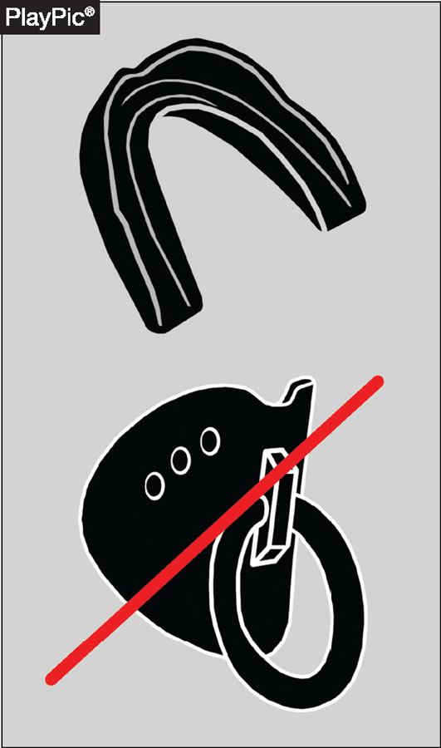
Player Equipment:
Tooth and Mouth Protectors
Equipment Requirements
Tooth and mouth protectors must:
Be properly molded or custom fitted
Be worn as designed for protection
Not Permitted
Protectors may not include attachments or features that:
Do not serve a protective function
Create additional safety risks
Purpose
Maintain player safety and reduce injury risk.
Notes:
This slide reviews the requirements for tooth and mouth protectors. All protectors must be properly molded or custom fitted and worn as designed for their protective function. Protectors may not include any attachments or features that do not serve a protective purpose or that create additional safety risks. The overarching goal is to maintain player safety and minimize injury risk on the field.

Slide 18
NFHS Officials Education

Slide 19

All Things Officiating in One Place!
The all-in-one, cloud-based NFHS Center for Officials Services (COS) connects everyone associated with officiating. The COS handles registration, assignments, testing, payments, and a host of other features and integrations that consolidate all officiating needs into a single, modern solution. Free to all NFHS state associations, local associations, and assigner groups.
20+
Member States
300,000+
Officials
7,000+
Schools
Notes:
This is our all-in-one, cloud-based hub — the NFHS Center for Officials Services, or COS — it connects everyone involved in officiating. It handles registration, assignments, testing, payments, and a whole host of other features and integrations, so all your officiating needs live in one place. And here's the best part: it's completely free for every NFHS state association, local association, and assigner group.

Slide 20
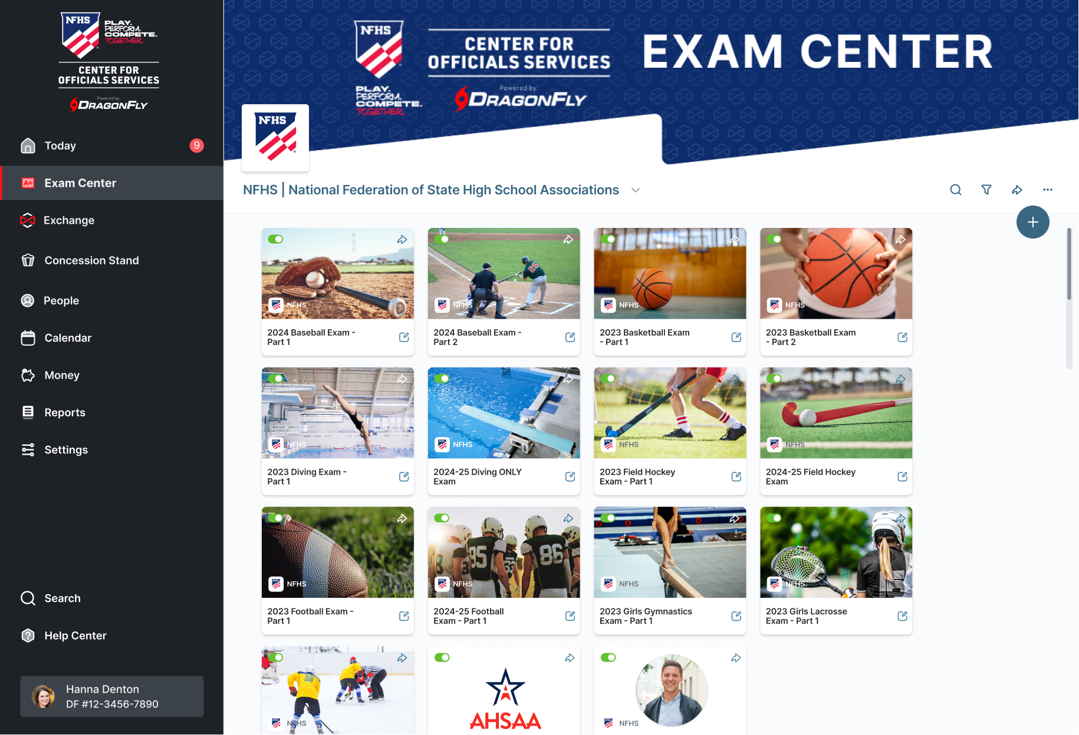
Improved Exam Center
Notes:
Improved Exam Center:
• So we've completely redesigned the Exam Center, and it's now built right into the NFHS Center for Officials Services.
• It's a cleaner, more modern interface, and makes it a lot easier for officials to find, take, and finish their required tests.
• And on the admin side, it streamlines everything — giving exams, tracking results, and managing credentials all in one place.

Slide 21
NFHS Learning Center
Notes:
Over the next few slides, I want to walk you through some of the resources we have available for your coaches, parents, and students.

Slide 22

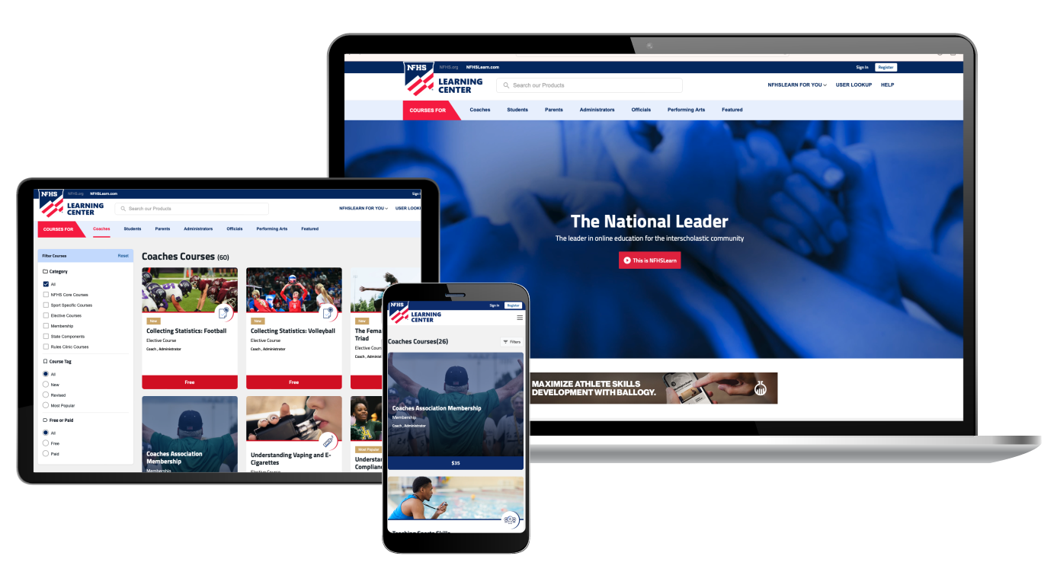
The National Leader
100+ Online Courses
75+ Available at No Cost!
Active in All 50 States
Valuable Professional Development
Earn Completion Certificates
Earn National Credentials
Earn Badges
www.nfhslearn.com
Notes:
The NFHS Learning Center is really your one-stop home for more than 100 online professional development courses — for coaches, students, officials, parents, administrators, and performing arts programs. With more than 70 of these courses being completely free.

Slide 23
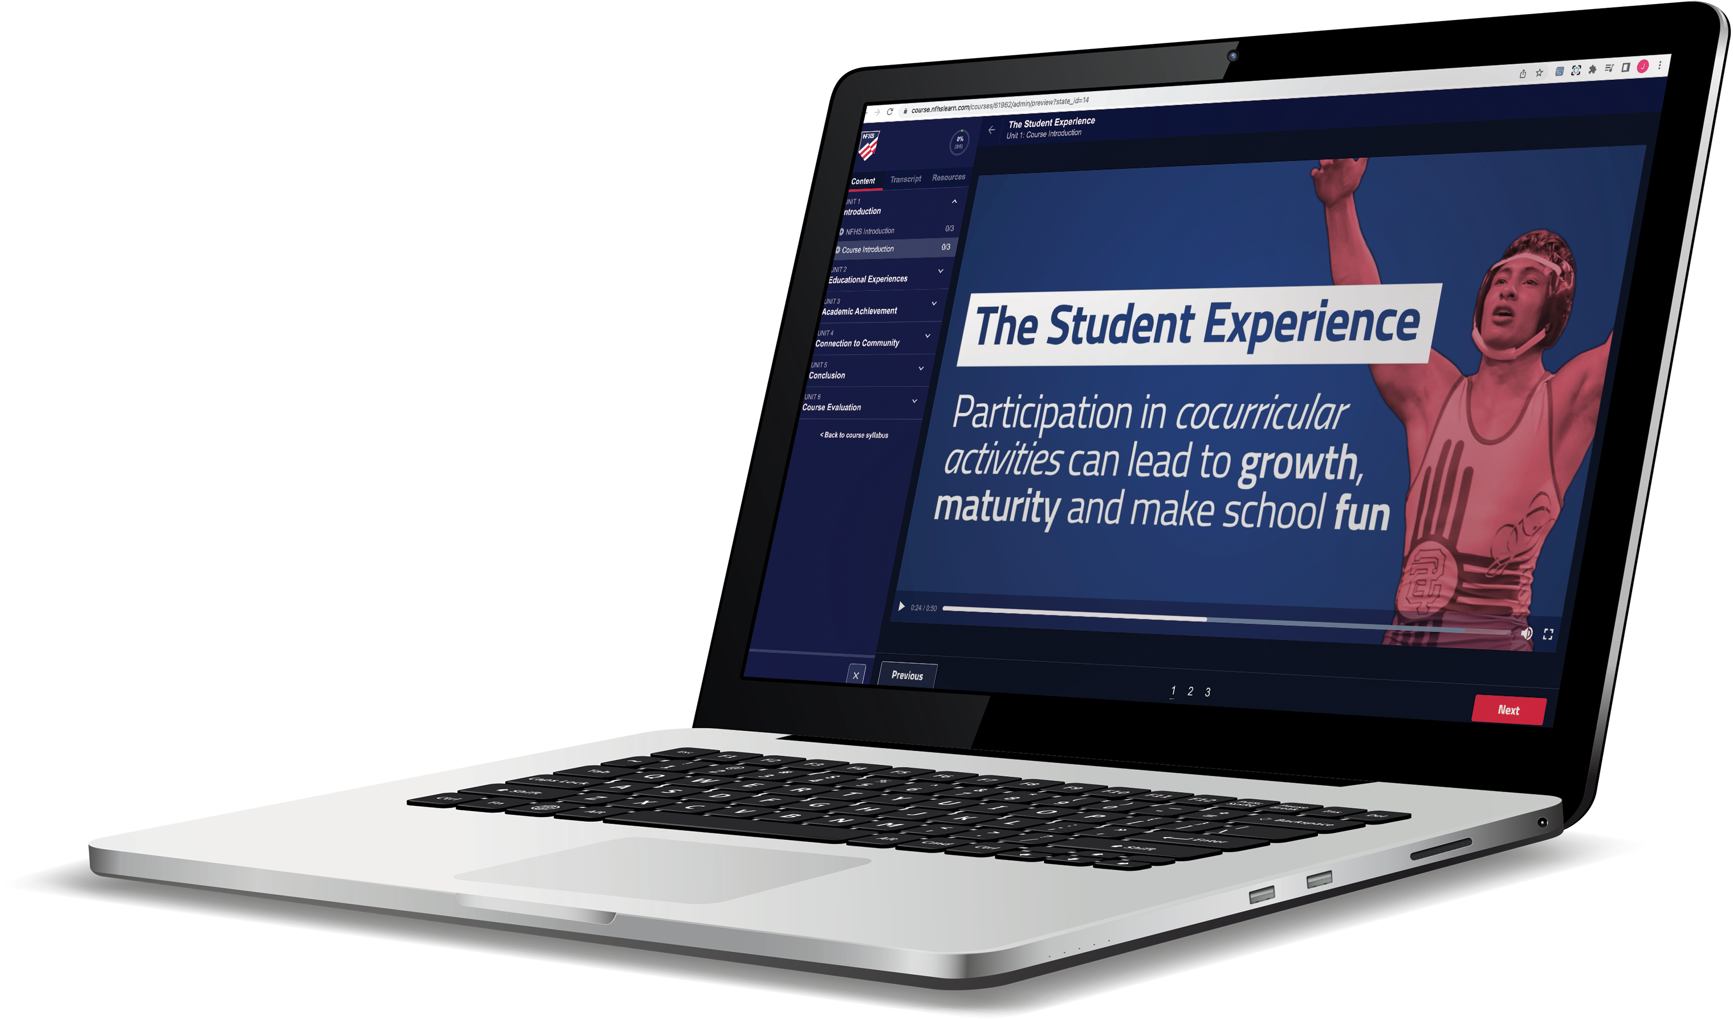
Over 29 million courses delivered!
Concussion in Sports – 9.2M+
Heat Illness Prevention – 3.6M+
Sudden Cardiac Arrest – 3.9M+
Concussion for Students – 2.1M+
The Collapsed Student (2020) – 108,000+
CPR & AED Training (2023) – 55,500+
Sportsmanship – 1.7M+
Fundamentals of Coaching – 1.1M+
First Aid, Health and Safety – 505,000+
Bullying, Hazing and Inappropriate Behaviors – 658,000+
Student Mental Health and Suicide Prevention – 460,000+
Coaching Mental Wellness (2025) – 37,750+
Emergency Action Planning for Afterschool Programs (2025) – 14,600+
Notes:
The NFHS Learning Center has now delivered more than 29 million course completions across the high school community.
• A lot of that is driven by our flagship safety courses — Concussion in Sports leads the way at 9.2M+, followed by Sudden Cardiac Arrest at 3.9M+, Heat Illness Prevention at 3.6M+, and Concussion for Students at 2.1M+.

Slide 24

NFHS Network

Slide 25
NFHS Network
27 Different Sports and Activities.
By 2028, every high school event
in America will be streamed live.
The NFHS Network will be
THE DESTINATION for fans.
OUR NETWORK
www.NFHSnetwork.com
Notes:
The NFHS Network is a website and an app where fans can watch high school sports and activities, both live and on replay. Right now it covers 27 different sports and activities, and by 2028, every single high school event in America will be streamed live.

Slide 26

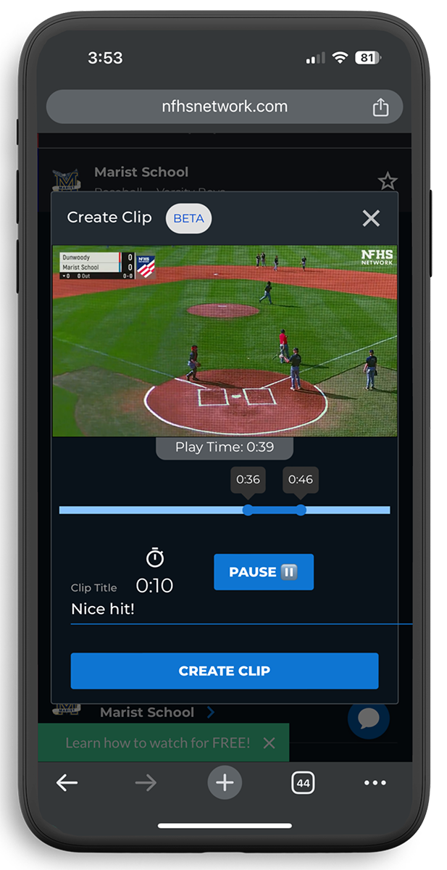
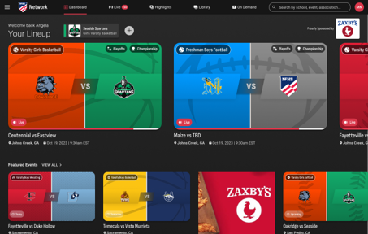
Capture Your Memories –
Clip and Share
Allowing fans to capture and share their favorite moments
Notes:
• One new feature is the clip-and-share — it lets fans grab their favorite moments right from a broadcast and post them straight to social.
• If your school isn't part of the NFHS Network School Broadcast Program yet, I'd really encourage you to reach out to us at Mark.Koski@NFHSnetwork.com.

Slide 27

NFHS Authenticating Mark
Requirement
All balls used in NFHS interscholastic competition must display the NFHS Authenticating Mark.
Purpose
Confirms equipment meets NFHS performance standards
Ensures consistency and fairness in competition

